Slide 1
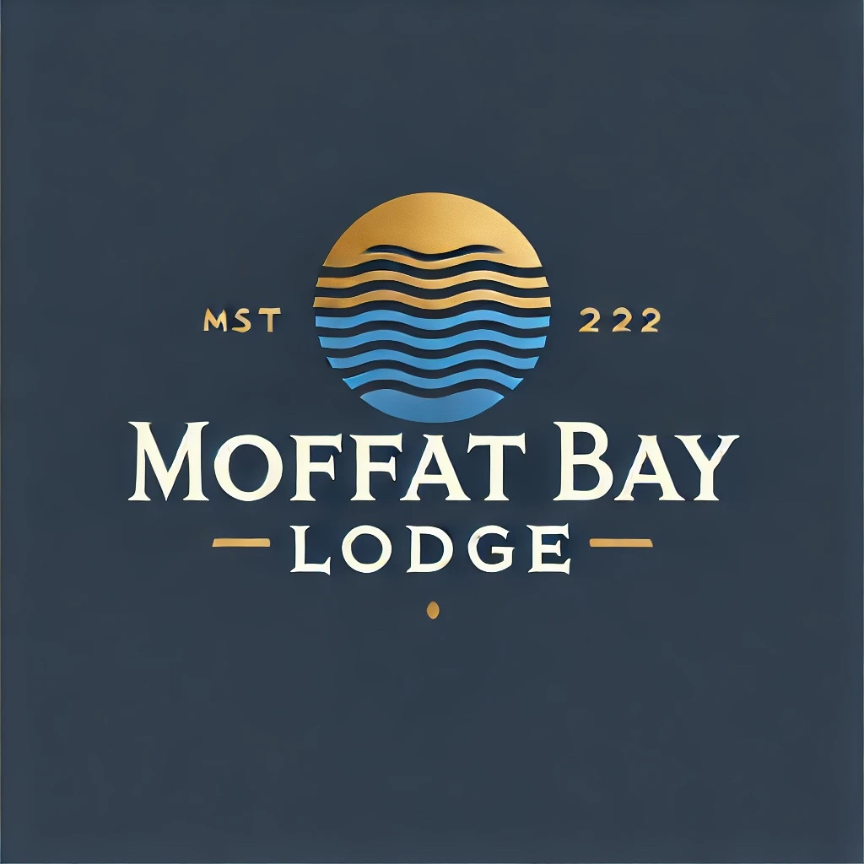
Moffat Bay Lodge Team Charlie
Marie Battle
Joshua Hamm
Erik Hernandez
Kody Pope
Assignment 11.1
QA Testing

Slide 2
Moffat Bay Lodge Team
Marie Battle - Developer
- Role: Responsible for implementing features and fixing bugs.
Joshua Hamm - QA Tester
- Role: Conducts testing to ensure quality and functionality.
Kody Pope- Project Manager
- Role: Oversees project timelines and team coordination.
Eric Hernandez - UX/UI Designer
- Role: Designs user-friendly interfaces and improves user experience.

Slide 3

Introduction to Prototypes
Overview of Prototypes:
- Prototypes are preliminary versions of our application designed to visualize user experience and functionality.
- They allow us to gather feedback and make iterative improvements before final development.
Key Features:
- Login: Secure access for users to their personal accounts.
- Attractions: Showcase local attractions with engaging visuals.
- Reservations: Easy-to-navigate reservation system for booking activities.
- Book a Room: Seamless process for room bookings at Moffat Bay Lodge.
- Contact Us: Quick access to customer support and inquiries.
- About Us: Information on Moffat Bay Lodge’s mission, values, and team.
Purpose of Prototyping:
- Enhance user experience by testing ideas quickly.
- Validate functionality and design with real user feedback.
- Identify potential issues early in the design process.

Slide 4
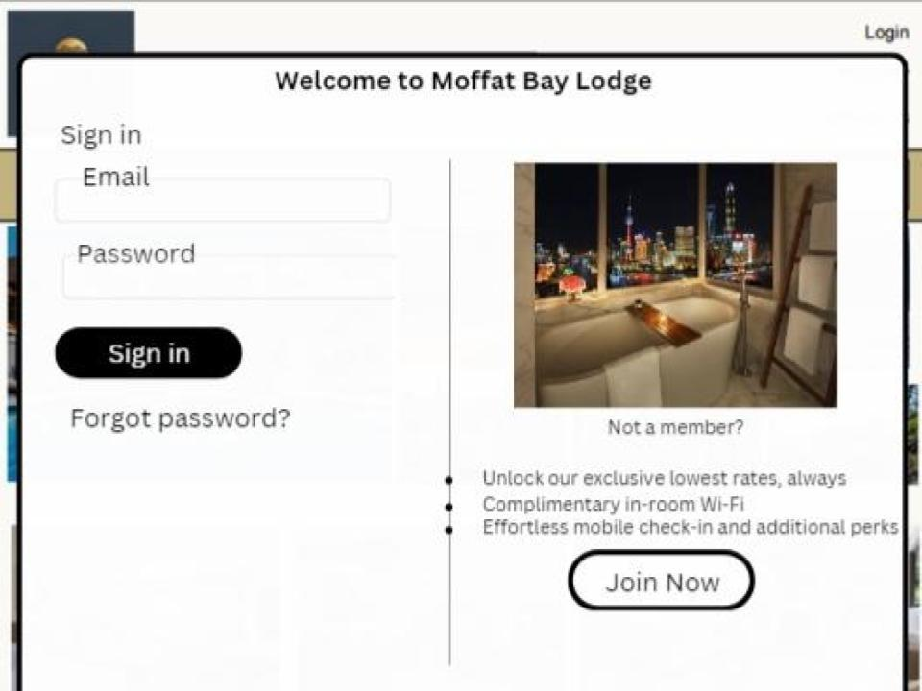
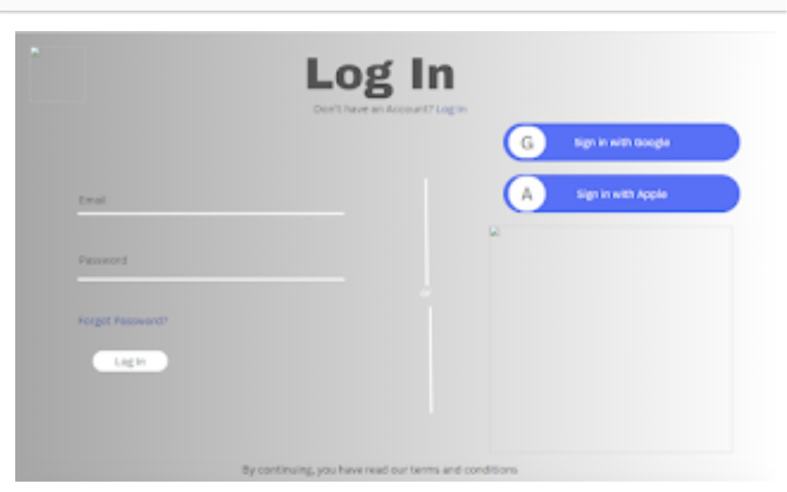
Login - Prototype
Guests can securely log in or create an account with minimal steps. The interface is intuitive, ensuring quick access to personal bookings and details.

Slide 5
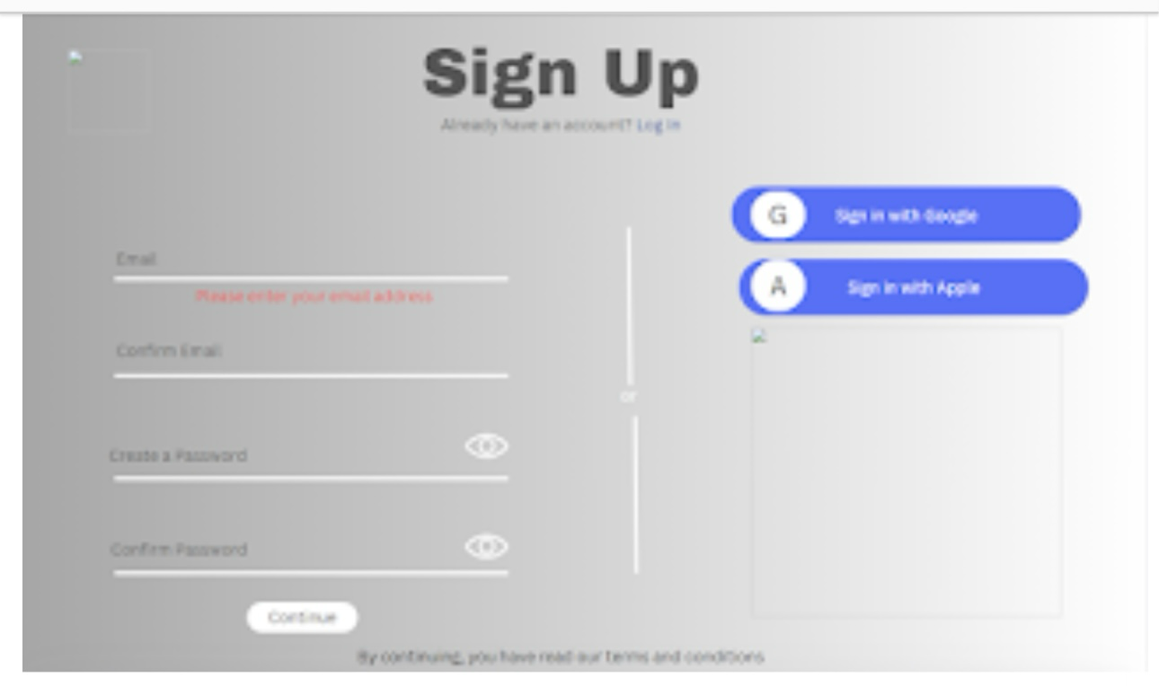
Sign Up - Prototype
Seamless Registration Process:
- Quick and intuitive sign-up form for new guests.
- Minimal required fields to encourage completion.
- User-Friendly Design:
- Modern and appealing interface for a pleasant experience.
- Accessible on both mobile and desktop devices.
introducing guests to Moffat Bay Lodge and its offerings.

Slide 6
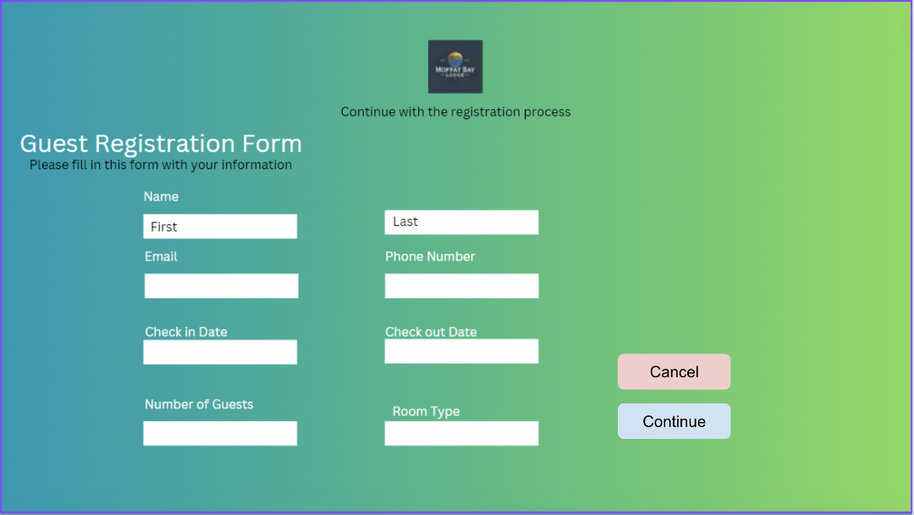
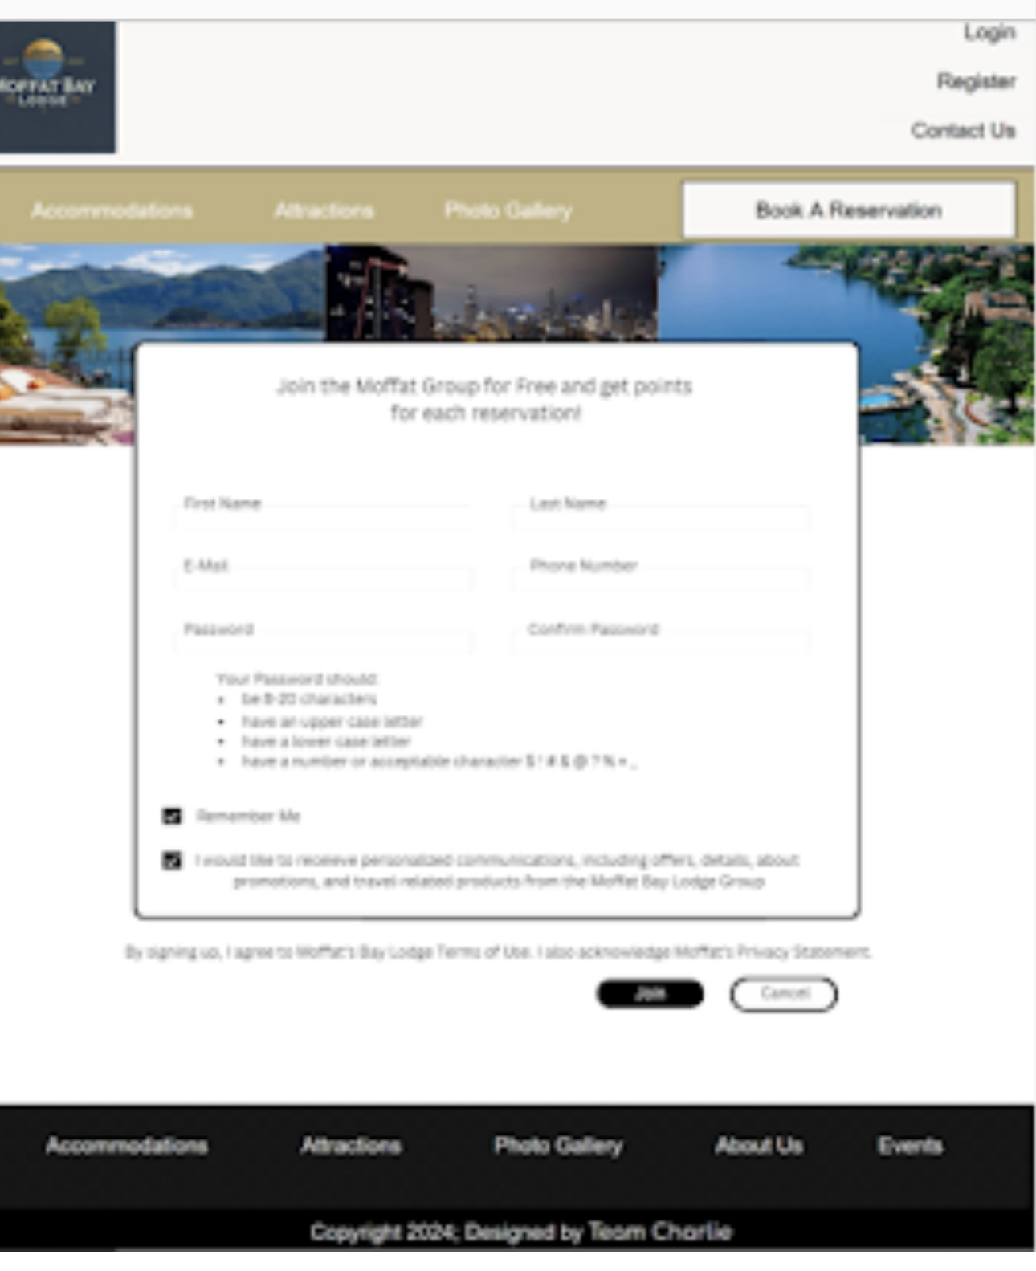
Registration - Prototype

Slide 7
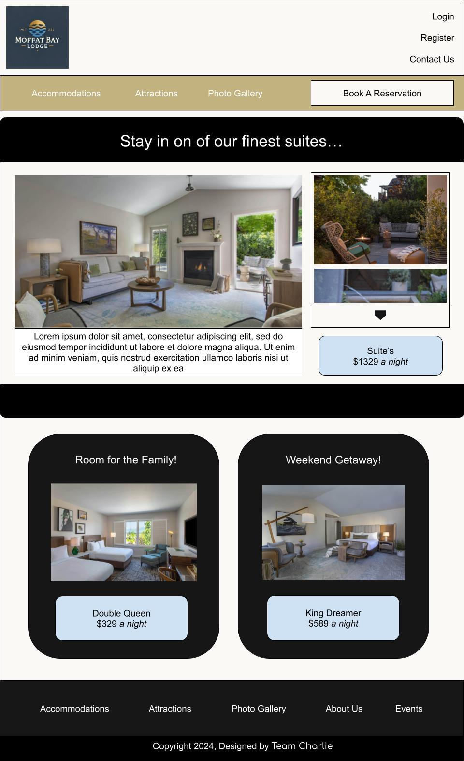
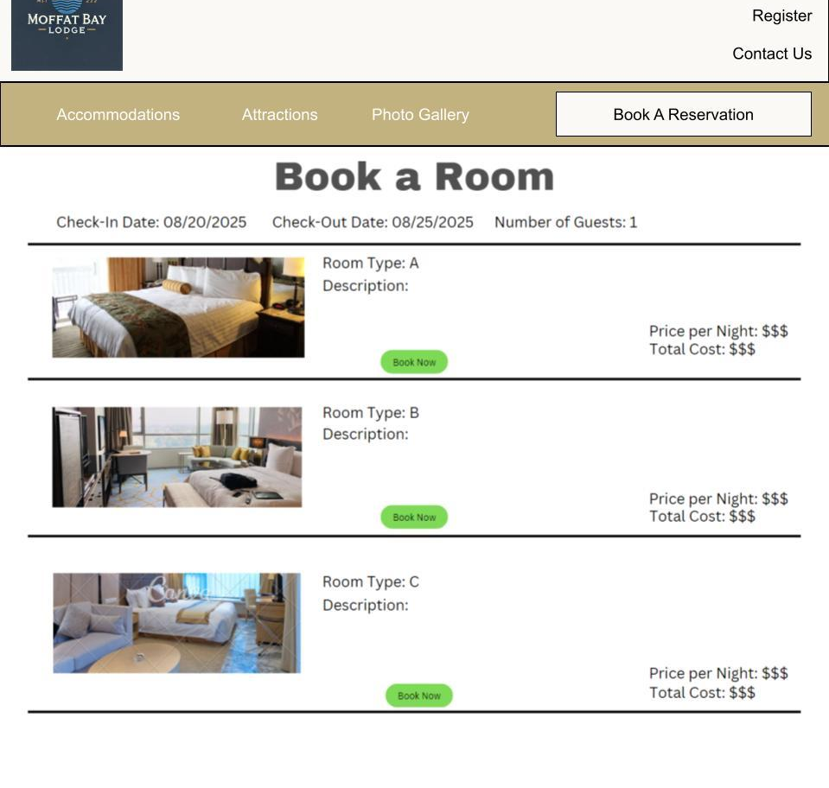
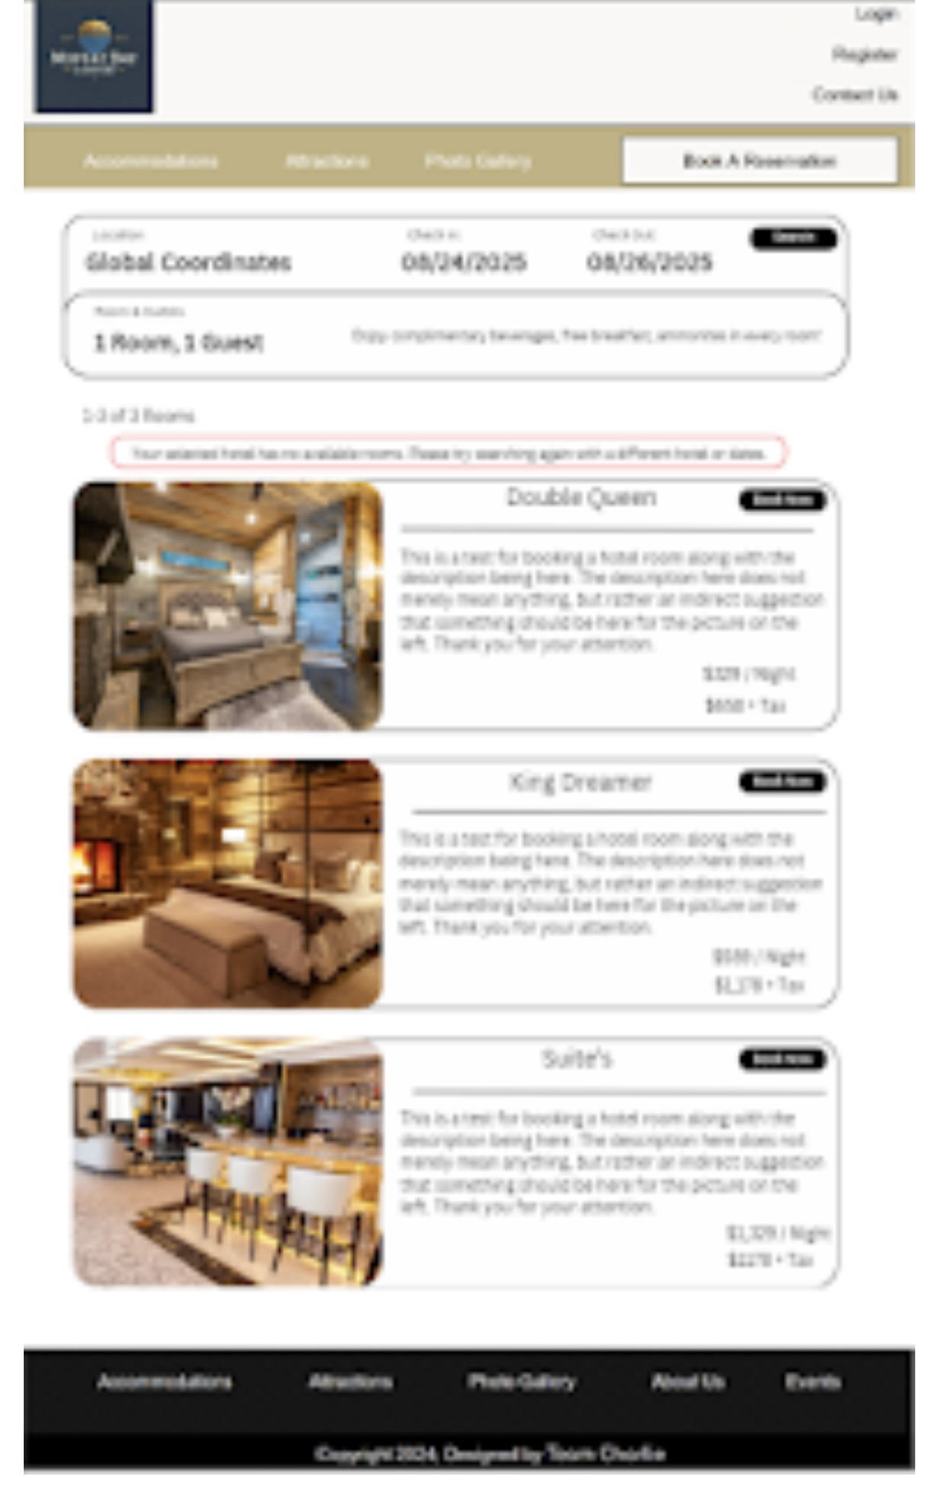
Book a Room - Prototype
Choose from an array of luxurious accommodations:
- Double Queen Room: Ideal for families or groups.
- King Dreamer: Offers premium comfort with beach views.

Slide 8
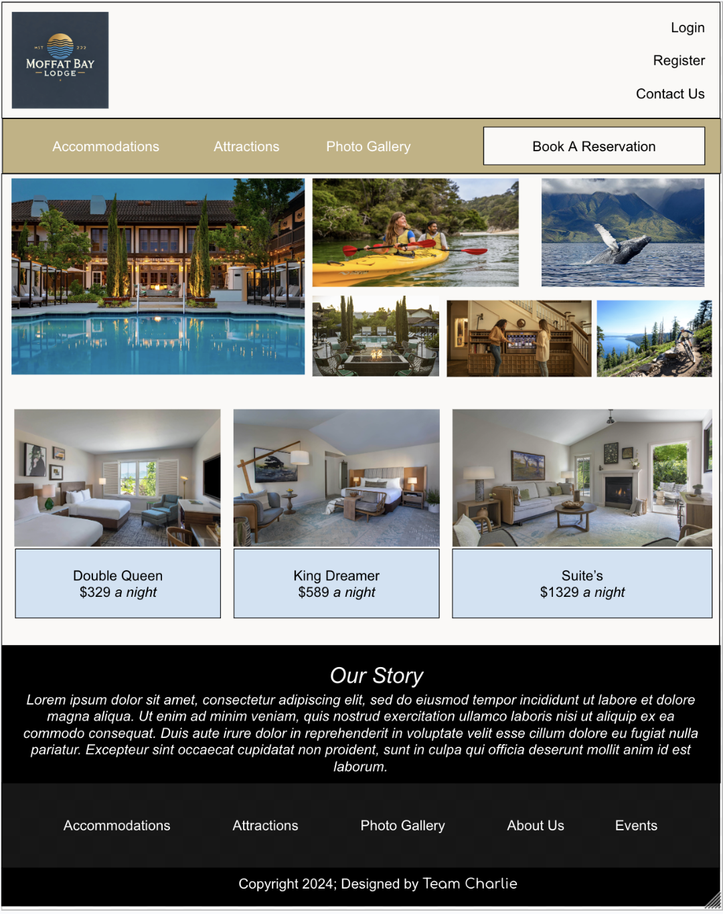
Homepage Prototype

Slide 9
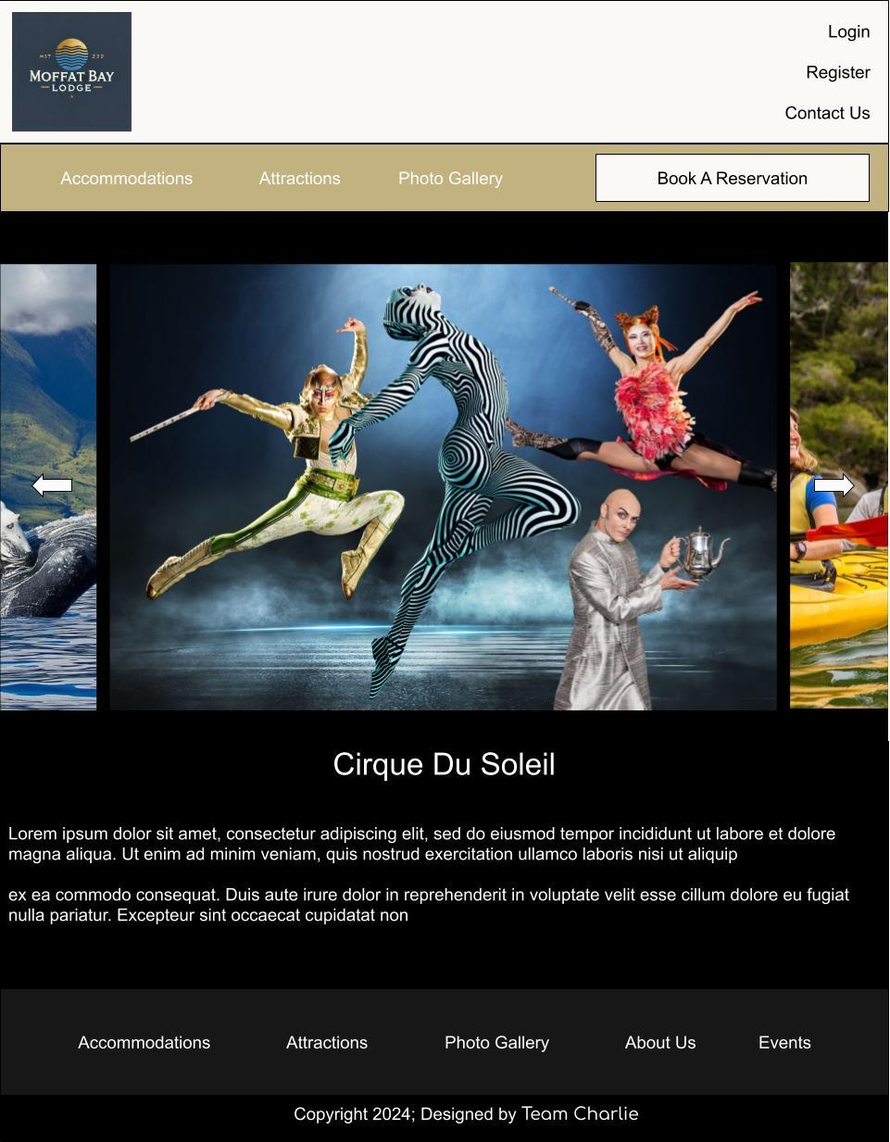
Events - Prototype
Explore breathtaking local attractions, including:
- Moffat Bay Beach: Pristine shores perfect for sunbathing and water sports.
- Nature Trails: Scenic paths winding through lush forests.
- Wildlife Excursions: Guided tours for bird watching and eco-discovery.
- Stunning visuals highlight the beauty of the surroundings to entice visitors.

Slide 10
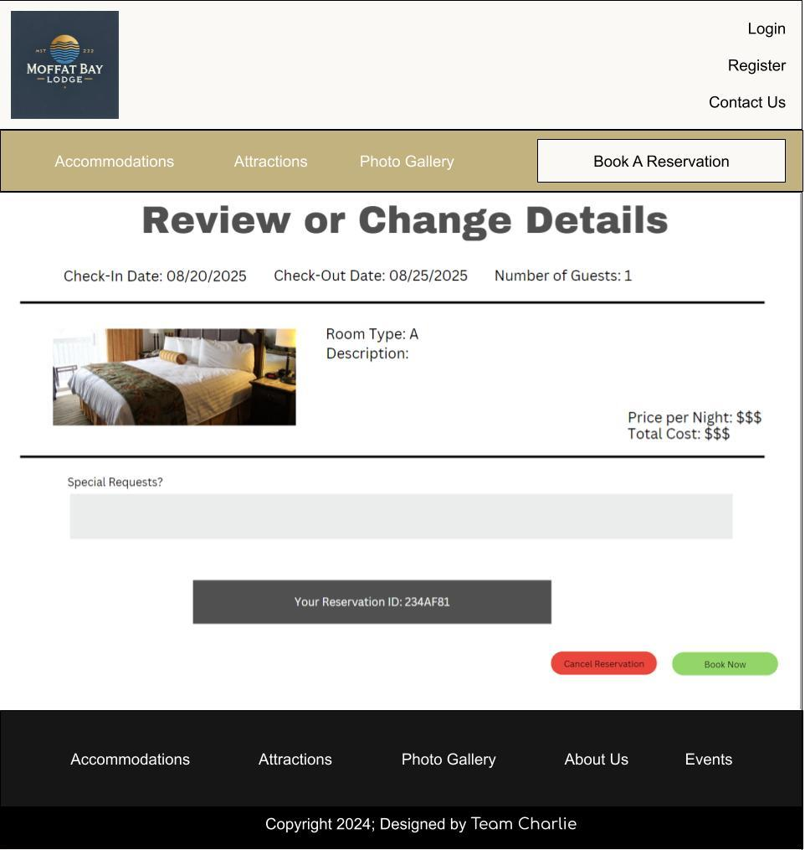
Review or Change Details - Prototype

Slide 11
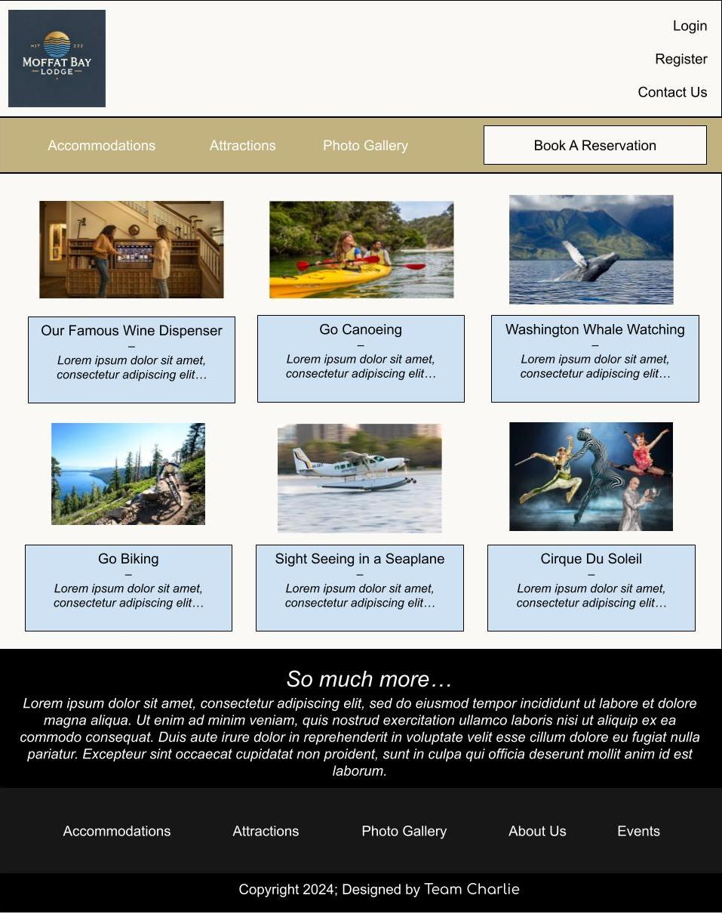
Attractions - Prototype
Explore breathtaking local attractions, including:
- Moffat Bay Beach: Pristine shores perfect for sunbathing and water sports.
- Nature Trails: Scenic paths winding through lush forests.
- Wildlife Excursions: Guided tours for bird watching and eco-discovery.
- Stunning visuals highlight the beauty of the surroundings to entice visitors.

Slide 12
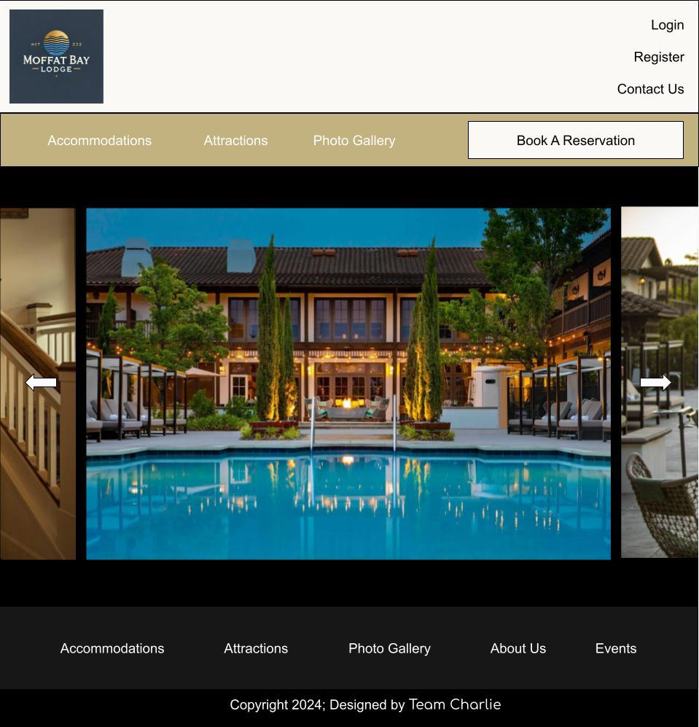

Gallery - Prototype

Slide 13
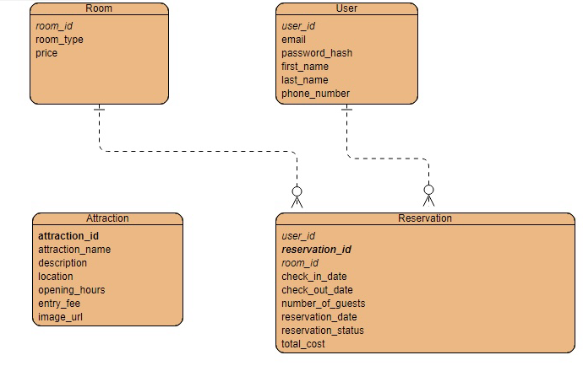
Visual ERD Representation

Slide 14
Explanation of Key Entities and Relationships
Room: Contains information on available rooms including room ID, type, and price.
User: Represents users with attributes such as user ID, email, and personal details.
Attraction: Lists attractions with details like attraction ID, name, description, and entry fee.
Reservation: Manages booking information linked to both Users and Rooms, including reservation dates and costs.

Slide 15
Introduction to Test Cases
Overview:
The following slides outline a series of test cases designed to evaluate key functionalities of our application.
Each test case aims to ensure that the system meets specified requirements and performs as expected.
Objectives:
Validate user interactions and ensure a seamless experience.
Confirm proper functionality and responsiveness across various components of the application.
Importance:
Comprehensive testing is crucial for identifying bugs, ensuring reliability, and enhancing user satisfaction.

Slide 16
Attractions Content – Test Case 1
Test Objective: Verify that the attractions information displays correctly and meets content requirements.
Developer: Marie/Joshua
Date Tested: 09.29.24
Peer Tester: Joshua
Results:
Pass/Fail Summary: Yes
Comments: The page loads correctly, showing all attractions, descriptions, and images. The "Learn More" links had issues.
Steps & Results:
1. Navigate to the Attractions page - Pass
2. Check that all attractions are listed - Pass
3. Verify descriptions for each attraction - Pass
4. Check images -Pass
5. Test the "Learn More" links - Fail

Slide 17
Attractions Layout and Functionality – Test Case 2
Test Objective: Evaluate the layout and functionality of the Attractions page for usability and design consistency.
Developer: Marie/Joshua
Date Tested: 09.29.24
Peer Tester: Joshua
Results:
Pass/Fail Summary: Yes
Comments: Tested in multiple browsers; all functionality works correctly and displays responsively.
Steps & Results:
1. Open Attractions page - Pass
2. Check layout adjustment - Pass
3. Navigation bar functions - Pass
4. Inspect text/image alignment - Pass
5. Test interactive elements - Pass

Slide 18
Login Form– Test Case 3
Test Objective: Ensure the login form accepts valid input and displays appropriate messages for invalid credentials.
Developer: Marie Battle
Date Tested: 09.05.24
Peer Tester: Kody Pope
Results:
Pass/Fail Summary: No
Comments: Issues with incorrect password prompts; valid email did not receive appropriate feedback.
Steps & Results:
1. Load login page - Pass
2. Submit without credentials - Pass
3. Enter invalid email - Pass
4. Enter valid email but incorrect password - Fail
5. Enter valid email and password - Fail

Slide 19
Registration Form – Test Case 4
Test Objective: Ensures that users can update their profile information successfully.
Developer: Erik Hernandez
Date Tested: 9-30-24
Peer Tester: Kody Pope
Expected Results:
1. Update profile fields and submit
Profile is updated successfully
2. Submit with invalid data
Display appropriate error messages- Developer Pass/Fail: Yes
Tester Pass/Fail: No
Comments: Profile updated successfully, but error messages for invalid data were unclear.

Slide 20
Land Page – Test Case 5
Test Objective:
Verifies that the landing page loads correctly with the blur effect on the background when the "Login/Sign up" button is clicked.
Developer: Joshua Hamm
Date tested: 2024/09/05
Peer tester: Kody Pope
Date tested: 9-8-24
1. Open the landing page in a web browser
Expected Results:
The landing page loads, background image displays, and navigation bar appears.
Developer Pass/Fail: Yes
Tester Pass/Fail: Yes
2. Hover over the navigation links
Expected Results:
Links highlight or underline smoothly, with hover effect present.
Developer Pass/Fail: Yes
Tester Pass/Fail: Yes

Slide 21

Landing Page – Test Case 5 continued…
3. Click the "Login/Sign up" button
Expected Results:
The background blurs, and the form opens if necessary.
Developer Pass/Fail: Yes
Tester Pass/Fail: Yes
4. Check page responsiveness by resizing the browser window
Expected Results:
The page layout adjusts to fit different screen sizes.
Developer Pass/Fail: Yes
Tester Pass/Fail: Yes
5. Test navigation links by clicking on each
Expected Results:
Each link leads to the correct section/page.
Developer Pass/Fail: Yes
Tester Pass/Fail: No

Slide 22
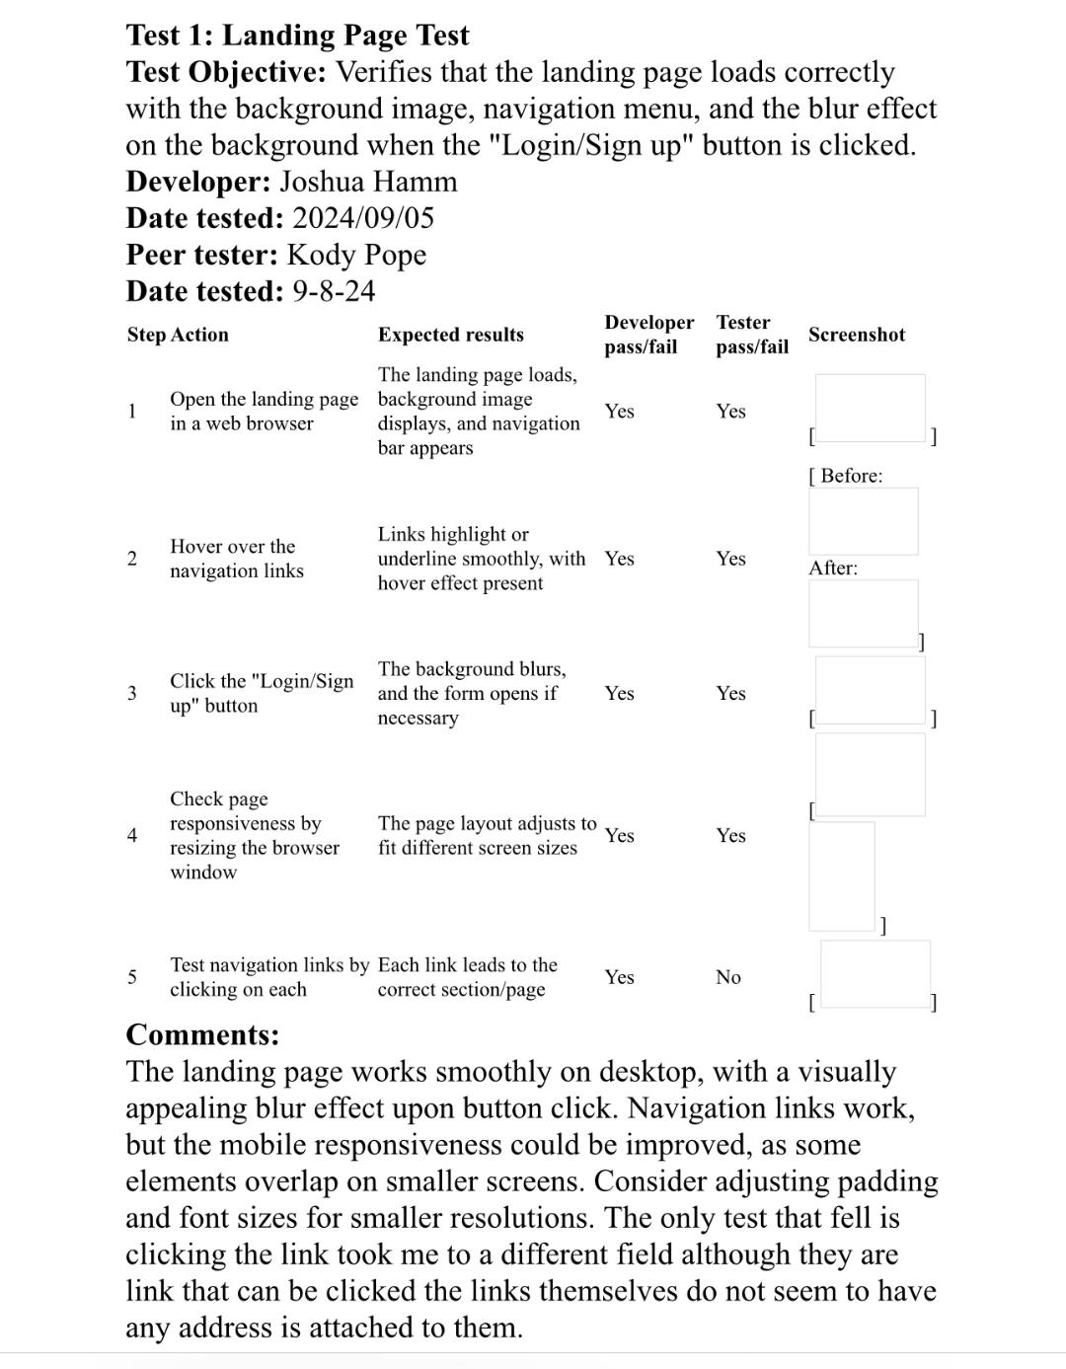
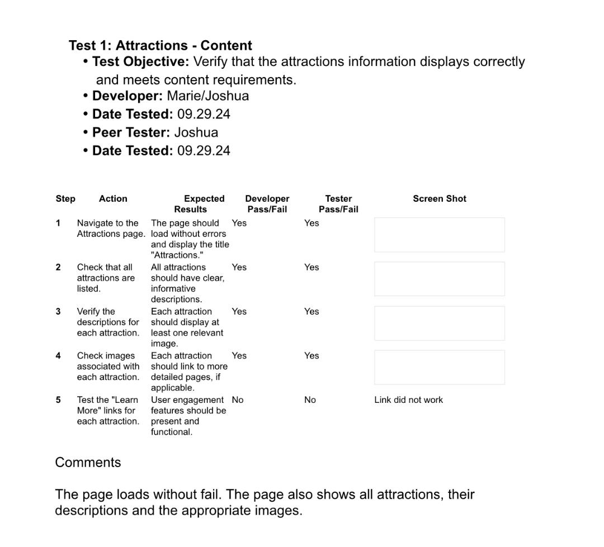
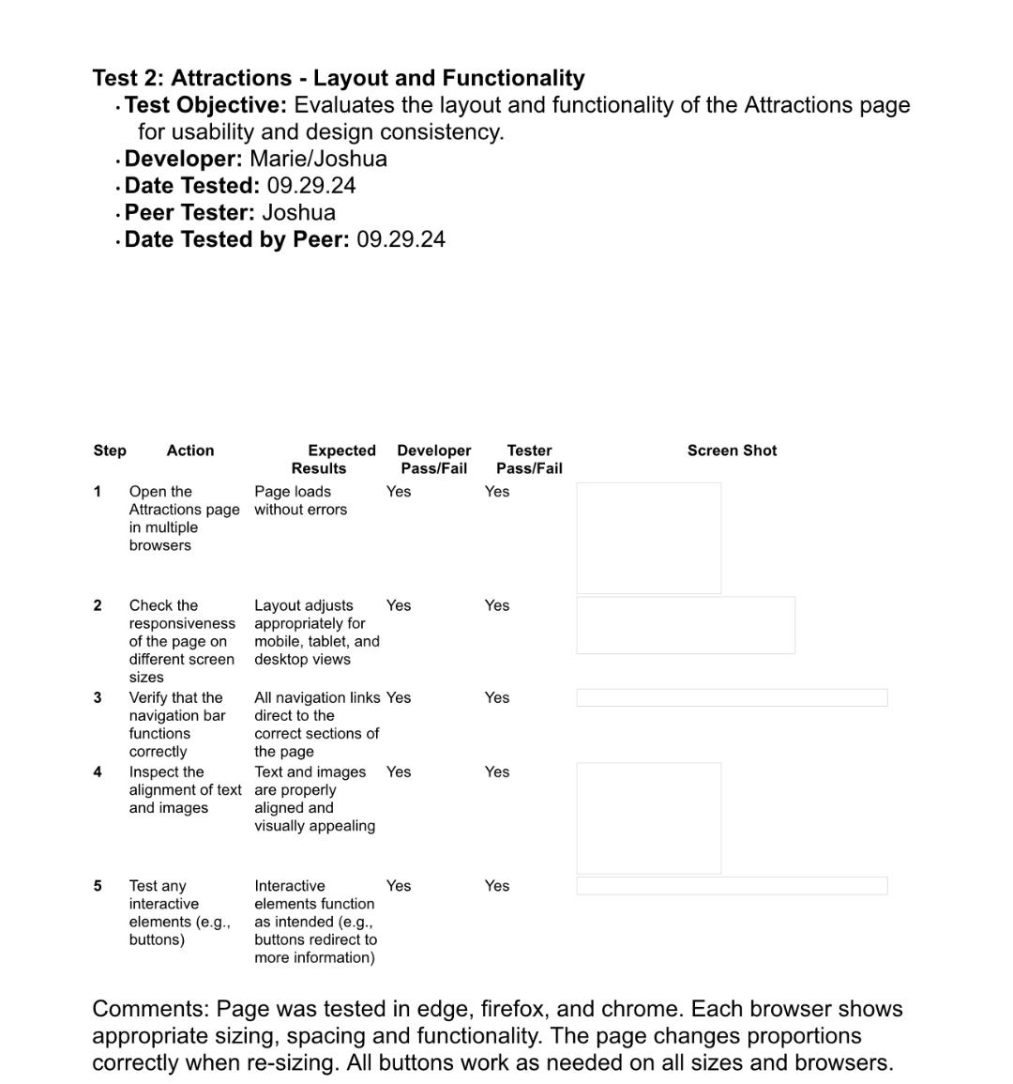
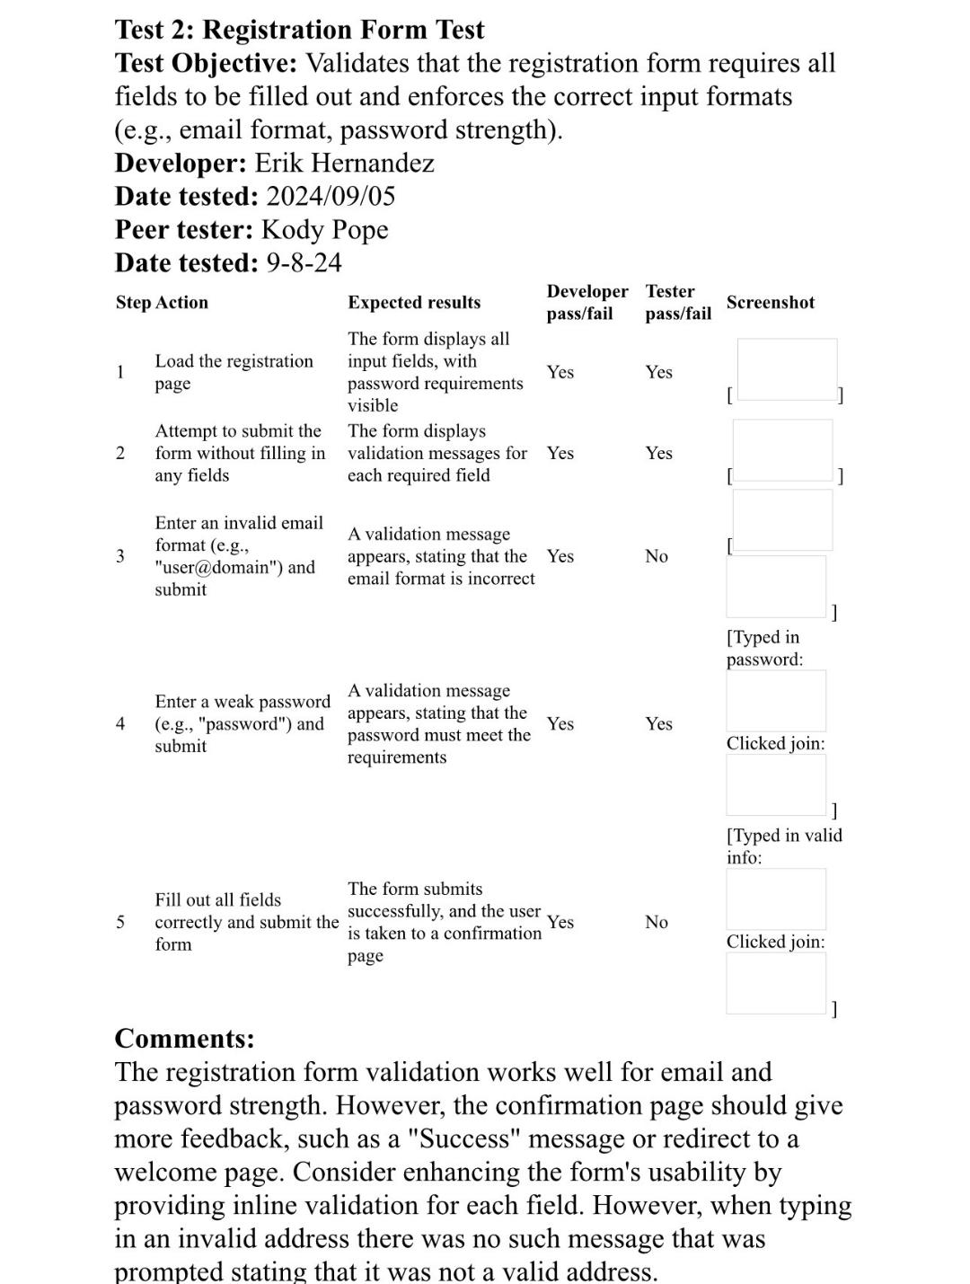
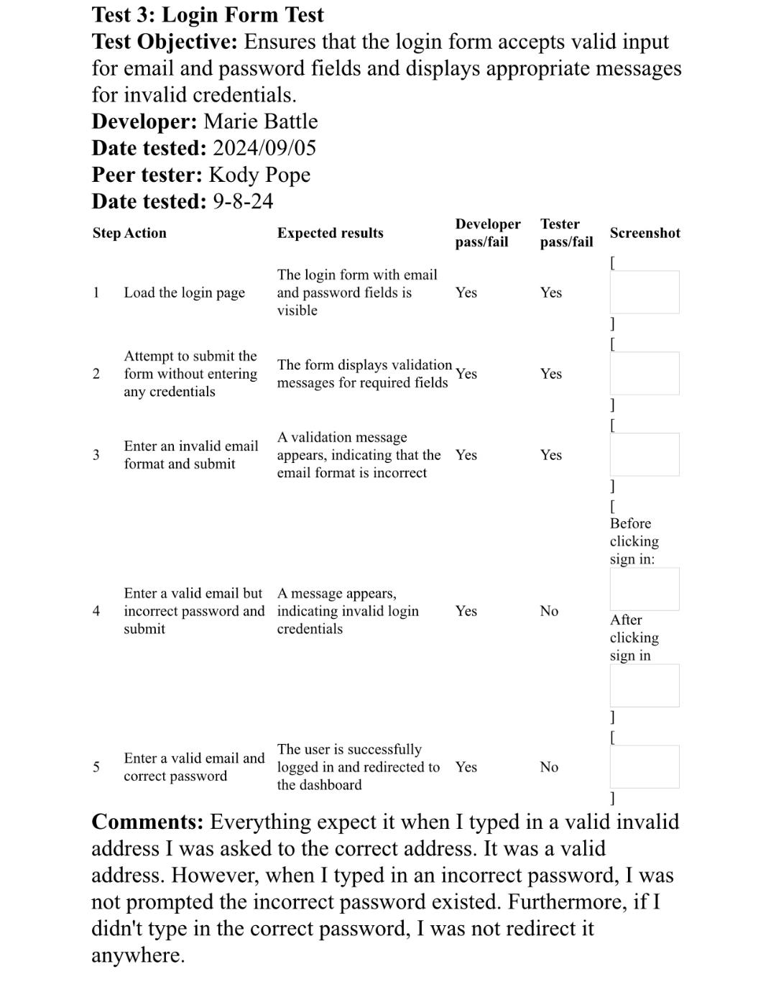
Test Case Images

Slide 23
Link to Test Cases
Login: https://docs.google.com/document/d/1ydhKK9c7EoJBaYY6F_Q0ELkXUpr4cVTU/edit
Reservation Summary and About Us: https://docs.google.com/document/d/1hida0stEGHUWeKMq0rt-UNujjLMumQ9j/edit
Contact Us and Look Up Reservation: https://docs.google.com/document/d/1eBTVS3uiQFu1t92QHeKdkoYyNVilSoPC/edit?usp=sharing&ouid=104714144269725915606&rtpof=true&sd=true
Booking a Room: https://docs.google.com/document/d/1Hl0CEZ5UcAwKVoMdwTmZzR93fU2NgIcO/edit?usp=sharing&ouid=104714144269725915606&rtpof=true&sd=true

Slide 24


Salish Salmon
The product owner wanted us to add a Salish Salmon to the landing page. We decided first to make the image’s background transparent, and then we made the image a link as an easter egg to something about Salish Salmon.

Slide 25
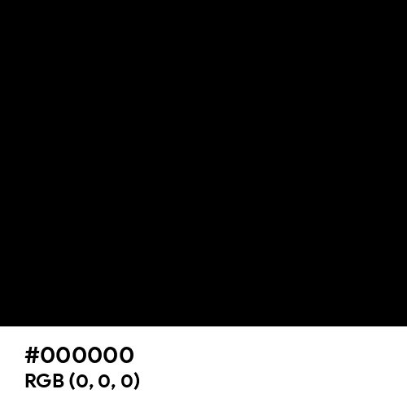
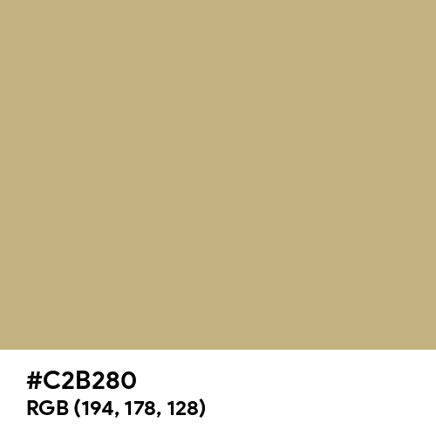
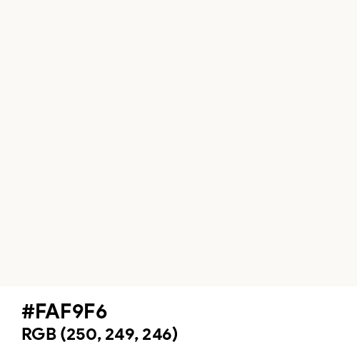
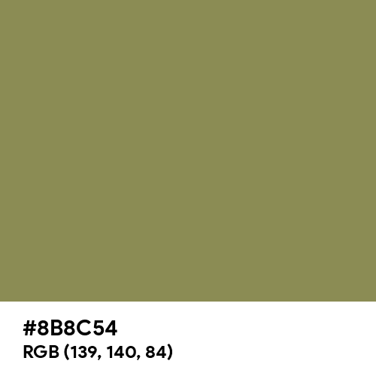
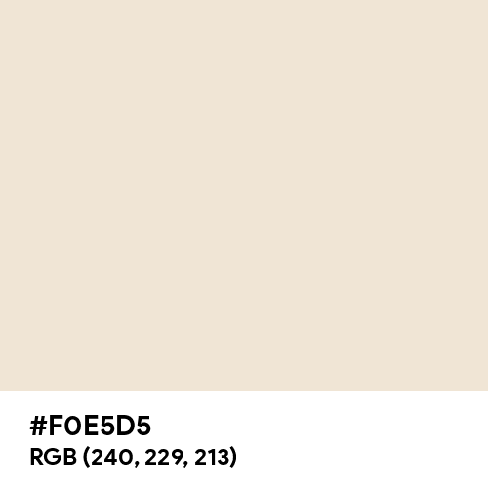
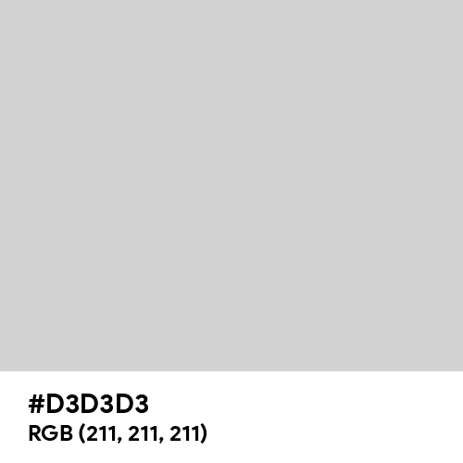
New Color Scheme
Old:
Based on customer feedback we have changed the color scheme to better suit the customers' expectations of the product.
Link to beta testers: https://docs.google.com/document/d/16qZkNUKwxlPKR6IkXvjljoh6ppTzYFHF/edit?usp=sharing&ouid=104714144269725915606&rtpof=true&sd=true
New:

Slide 26
Lessons Learned As A Team
Communication is Key:
Regular check-ins and open lines of communication can prevent misunderstandings and keep the project on track.
Documentation is Vital:
Consistent documentation of processes and decisions can aid in smoother transitions and help new team members get up to speed quickly
Flexibility in Approach:
Being open to adapting our strategies based on feedback has led to better solutions and improvements in project outcomes.
Testing Rigorously:
Comprehensive testing is essential to identify and resolve issues early, ensuring a smoother deployment.
Time Management:
Establishing clear timelines and meeting them helps in the efficient allocation of resources and prevents last-minute rushes.
Team Collaboration:
Encouraging collaboration among team members fosters creativity and results in more robust solutions.
Learning from Feedback:
Utilizing feedback constructively contributes to personal growth and enhances the overall team performance.
By reflecting on these lessons, we can continue to improve our processes and work effectively as a cohesive unit.

Slide 27
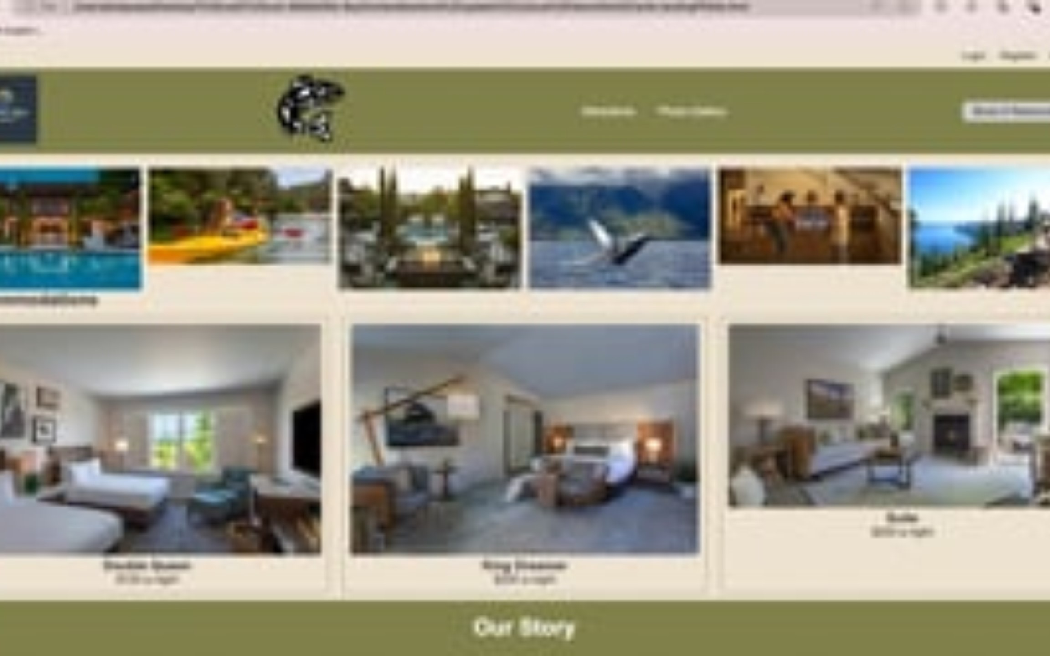

Slide 28
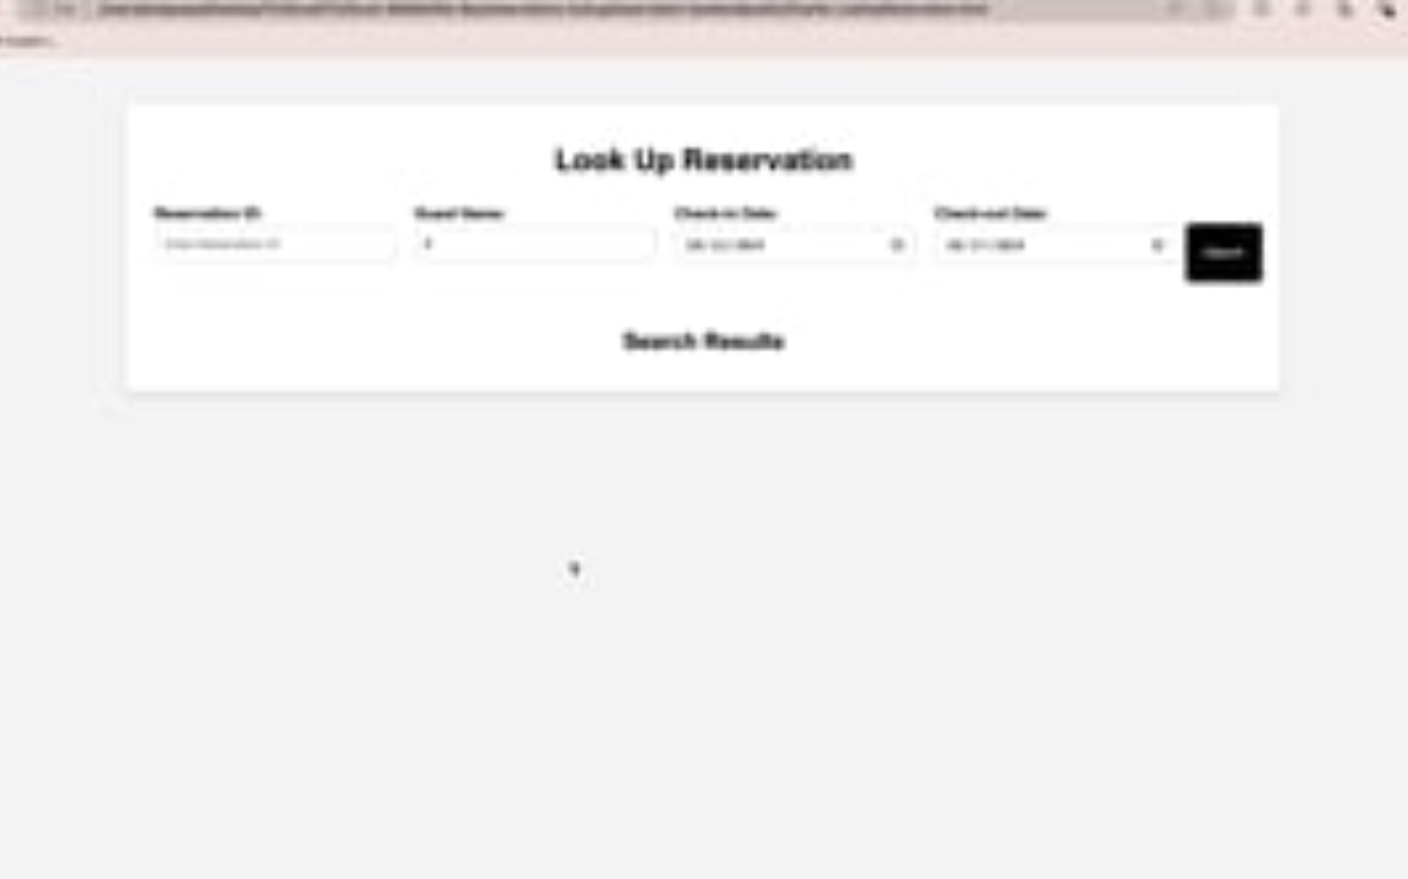

Slide 29
Our Project Links
Landing Page GitHub: https://github.com/kodypope/Moffat-Bay/blob/main/frontendbackend%20update%20Joshua%20Hamm/html/Charlie-landingPPAGe.html
GitHub Repo: https://github.com/kodypope/Moffat-Bay
Prototype: https://marvelapp.com/prototype/a8d9a9a/screen/95417627
Screen Recording part 1: https://drive.google.com/file/d/1df6CKdettBIhE8SSF0i0h0URxVYPn9e1/view?usp=sharing
Screen Recording part 2: https://drive.google.com/file/d/1QB0VWDtm_-2-tK9g94bYEc_Pmj6EDJym/view?usp=sharing

